Slide 1
Excel Final Assessment
Name – Dheeraj Bhardwaj
Em ID – 459
Date-

Slide 2
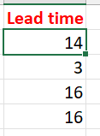
CASE STUDY-1
Calculated lead time with above formula.
Average = 24.038

Slide 3
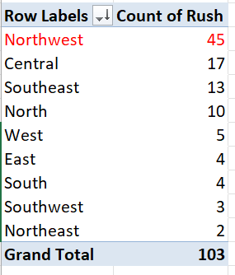
CASE STUDY- 2

Slide 4
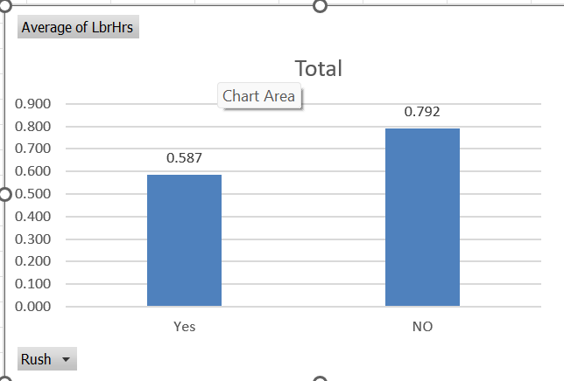
CASE STUDY-3
On average Rush job take 0.58 hr for completion.
And non rush job take .792 hr for completion
Which tells that worker works faster on jobs categorized as rush job.

Slide 5
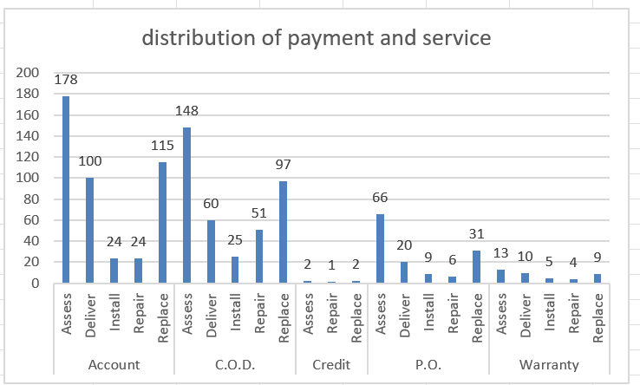
CASE STUDY- 4

Slide 6
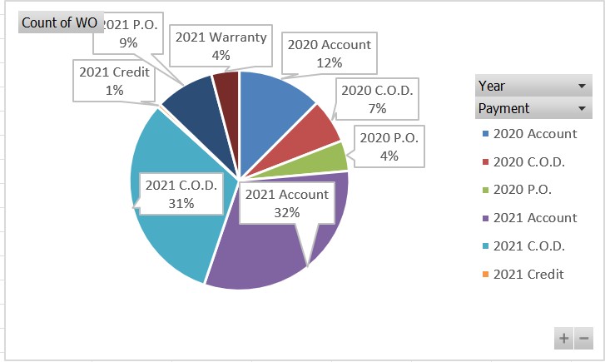
CASE STUDY- 5

Slide 7
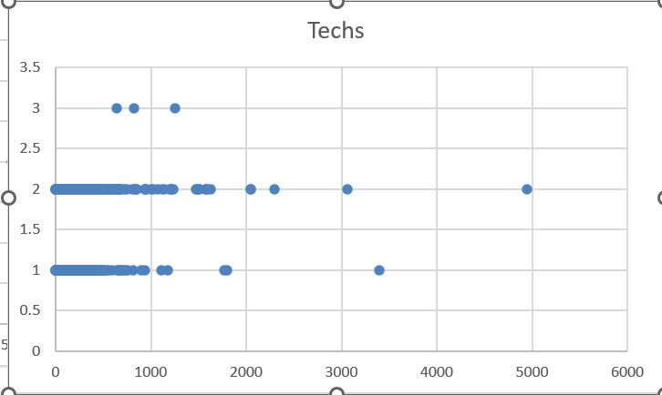

CASE STUDY- 6
There is no strong relation between them

Slide 8
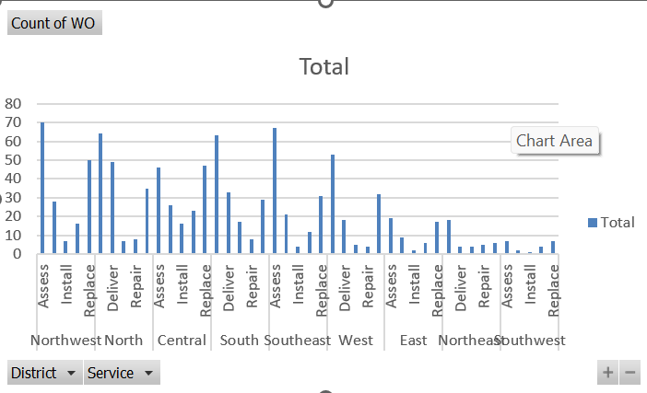
CASE STUDY- 7

Slide 9
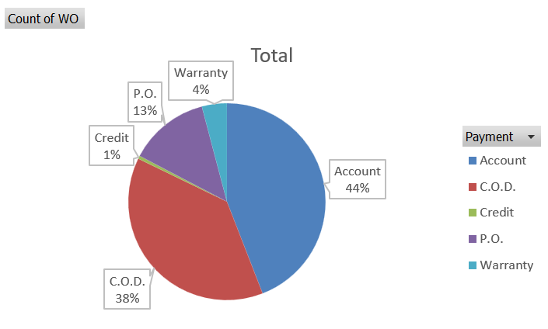
CASE STUDY- 8

Slide 10
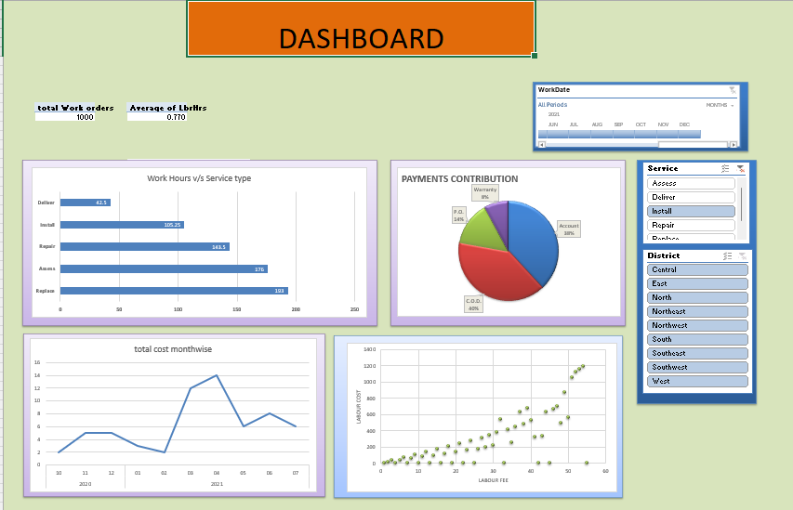
Dash board

Slide 11


Slide 12
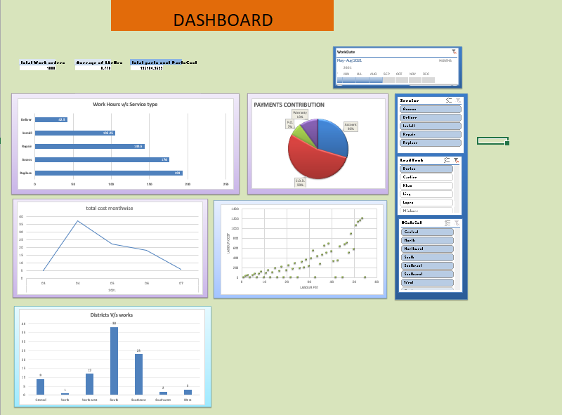

Slide 13
